Slide 1

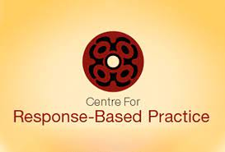
Taking a Fresh look at Violence
Response Based Practice
An Indigenous Mana-Informed Contextualised Approach

Slide 2






Standing on the shoulders of giants
Cathy Richardson
Riel Dupuis-Rossi
Allan Wade
Vikki Reynolds
Shelly Dean
Linda Coates

Slide 3

Evolution of ideas
Indigenous – understanding of what we already know and do, using situational context and respecting resistance to mistreatment
Systemic – understanding that violence occurs in the social world and not inside a person’s head
Social justice – understanding that people appreciate fairness, justice and situating their experience in context
Feminist contributions – understanding analysis of power imbalances
Upholding mana – understanding that dignity is central to life and wellbeing

Slide 4
A contextual analysis is necessary to understand why folks do what they do; ie: what they are responding to considering situational logic and personal logic.
Indigenous people are responding to multiple layers of covert and explicit violence every single day.
Violence effects every layer of a
person’s being from the macro to the mauri.
Mana is central to individual and collective wellbeing
Mana Ake
Mana Atua
Mana Whenua
Mana Tangata
Mana Motuhake
Time
----------------------------------------------------------------------------------------

Slide 5
Core principles of Response-Based Practice
Dignity / mana is central to social life and wellbeing
Violent acts are unilateral, non-consensual and occur in the social world
Violence is 99% deliberate, strategic and targeted
Wherever there is violence, there is resistance
Human beings are active ‘responding agents’ in a context not ‘impacted objects’
Social responses are crucial

Slide 6
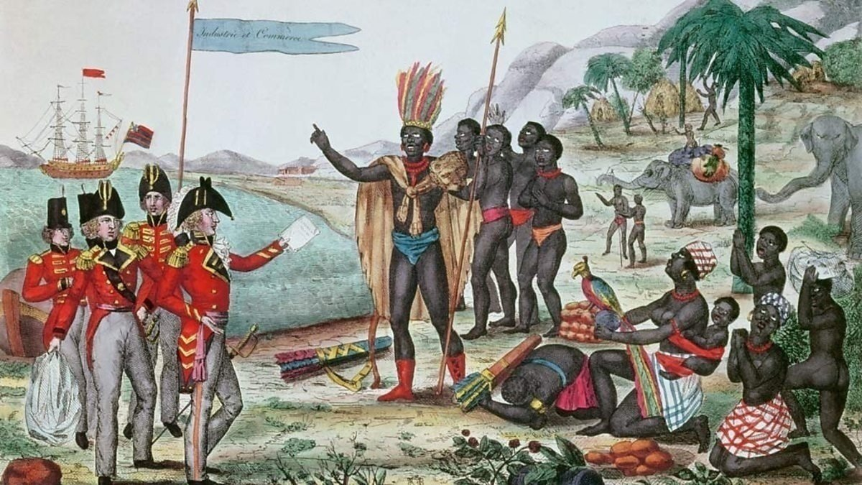
The colonial code of practice
“psycolonisation”
Todd and Wade (1994) called out the colonial code of relationship, which can be expressed as a three-part message:
1. You are deficient (ie: heathen, savage, falsely conscious, submissive, passive, internally oppressed, helpless, cognitively distorted and afraid).
2. I am proficient (critically conscious, expert, professional, qualified by the state)
Therefore I have the right (duty, sacred obligation, authority) to perform certain operations upon you (prescribing, advising, educating, assessing, praying, counselling, legislating, pathologizing, assessing, diagnosing)
….. for your own good.

Slide 7

Dignity and mana
Social life is organized largely around the according and preserving of dignity and mana (saving face)
Affronts to dignity create immediate social “problems” that participants work to repair
Humiliation requires “just redress” - failure to supply “just redress” leaves an open social wound

Slide 8
Mana and Resistance
For many victims, humiliation is the primary affront, the most lasting and painful injury
“The bruises go away but you never forget what he said to you.”
“He got my body but he didn’t get me.”
Responses and resistance are often oriented to preserving, asserting mana
The violence may be only the first in a series of indignities delivered through social responses
Our central task, whatever else we do, is to acknowledge
the mana of and to the victim

Slide 9
What is violence?
Uni-lateral
One person acts upon the will and well-being of another, involves power-over and control.
Social
Involving two or more people, takes place in the world, not in the mind.
Non-consensual
Legal definitions regarding age & consent, permission not granted or legally impossible.
Deliberate
People select their targets, locations for violence sites for bruises, away from witnesses.
Violence is...

Slide 10
Understanding context
When you see a small child sitting all by himself, what is the first thing you wonder about?

Slide 11
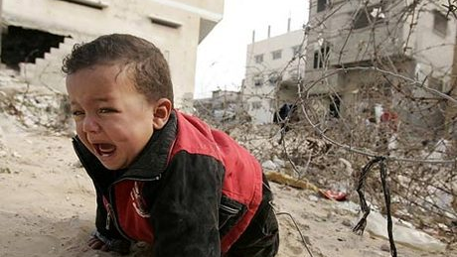

Slide 12
Context diag 1
A child alone….
with no context, with
no family…does not exist.
The Individual is an
Invention of western
psychology
Our species
would not
have survived
This.
DECONTEXTUALIZED PSYCHOLOGY

Slide 13
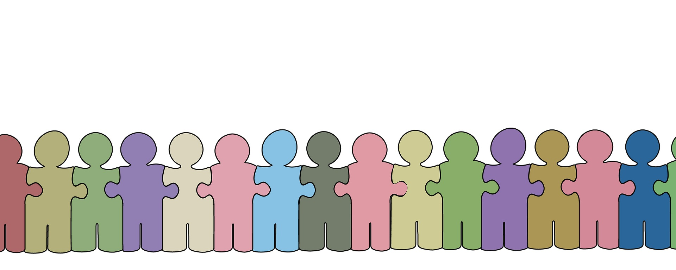
Inter-connectedness
We are all connected and inter-dependent
There are connections between personal, collective and ecological well-being
Positive ‘social responses’ to each other, especially people who are being hurt or excluded, is the best form of ‘healing medicine’

Slide 14
Context diag 2
The decontextualized, or “no context” individual,
portrayed as “an impacted object.”
IMPACT
PASSIVE
RECIPIENT
Descriptions that pertain to non-sentient objects… people are not passive objects

Slide 15
Context diag 3
ACTIVE
AGENT
SPIRITED
BEINGS
IMPACT
RESISTANCE

Slide 16
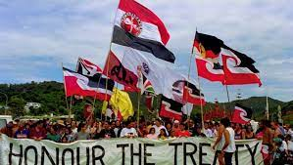
context context context
“Whenever people are treated badly, they resist” (Wade, 1999)
“To better understand violence we need to effectively understand dynamics of power and privilege” (Richardson, 2006)
Notes:
Protesters or protectors? Indigenous folks protest capitalism, harm of earth – why?

Slide 17
Context diag 4
SOCIAL
RESPONSES
SOCIAL RESPONSES
ACTION
IMPACT
EVENT
RESISTANCE
RESPONSE
ACTIVE
AGENT
Action
Response
Social Responses
Response to Social Responses

Slide 18

Examples:
What happens when....
Don drops a hot cup of coffee on the floor…
Don accidentally spills a hot cup of coffee
on Helen’s lap…
Don throws a hot cup of coffee at a window…
Don throws a hot cup of coffee at Helen …

Slide 19

Resistance alone does not stop the violence…
However, it serves to preserve dignity and uphold mana

Slide 20

“I totally lost my shit and must have punched her…… I can’t remember what happened…
I think I blacked out”
Len and Sarah’s story

Slide 21

Kiriana’s story
Situational logic over-rides
personal logic

Slide 22
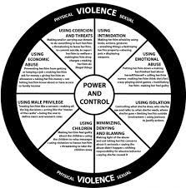
The Duluth wheel is out-dated, limited to white IPV, linear, and disappears resistance – conceals more than it reveals yet is STILL being used as a training tool in anti-violence programmes across sectors and across Aotearoa!!!!

Slide 23
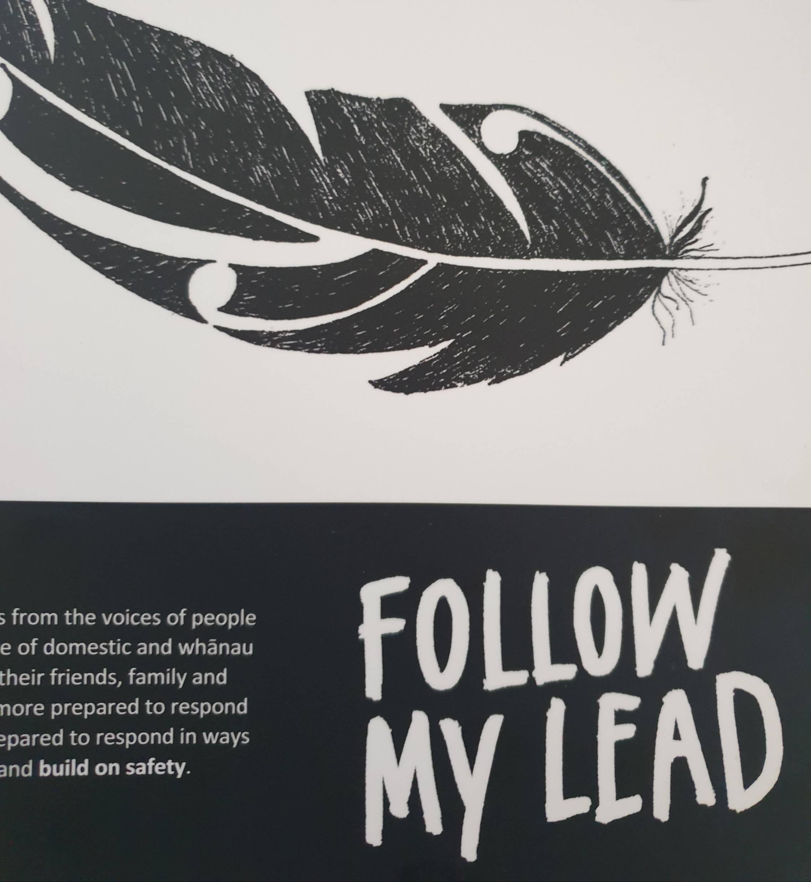
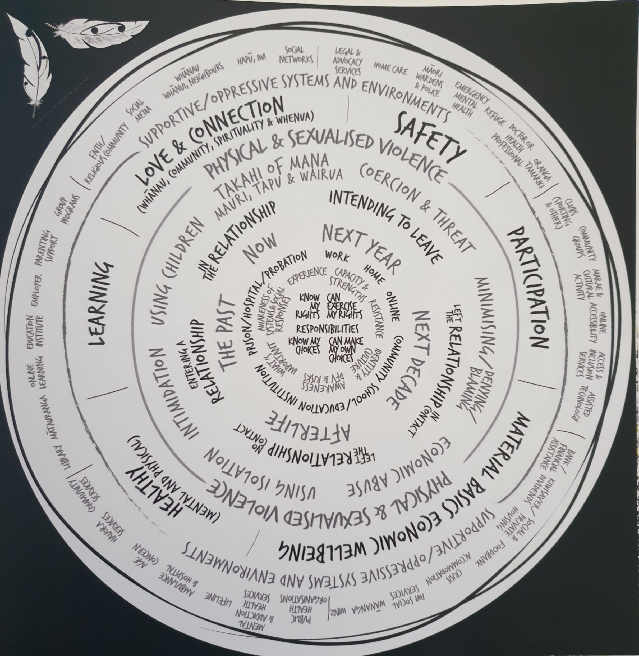
Navigating safety, that is, responding to social responses (often to temper violence from others) requires a full range of complex skills – much more relevant than Duluth wheel
Notes:
Effective training tool

Slide 24
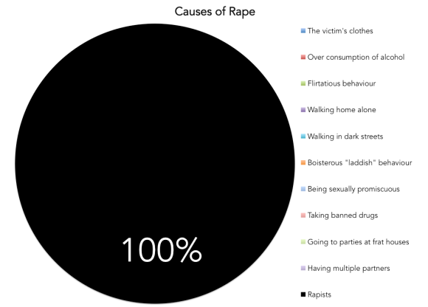

Slide 25
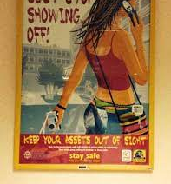
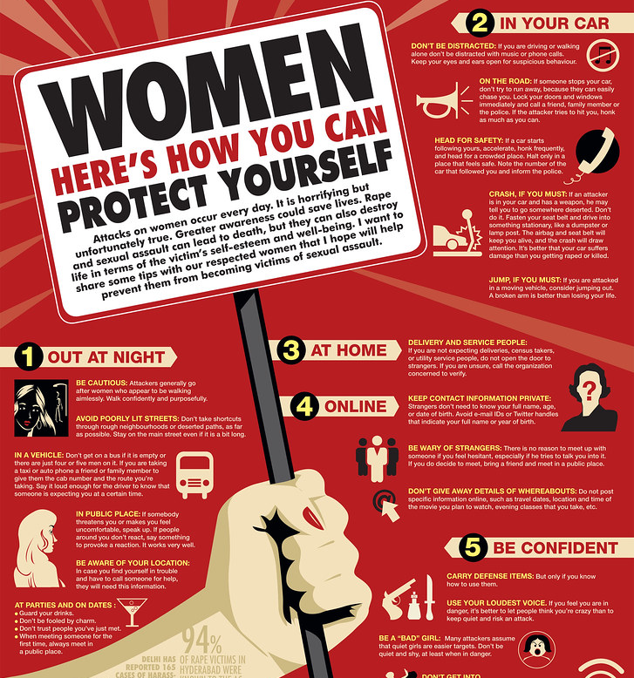
Notes:
Women are not vulnerable, they are vulnerablised

Slide 26
Posters you won’t see for rapists
Buddy up when you go out in case you get triggered into raping someone
Carry a personal safety alarm and blow it when you think you will beat someone up
Use your loudest voice and scream for help if you are at risk of harming someone
Leave women alone in bars but feel free to grope yourself on your way to the toilets

